Slide 1
NOAA Storm Damage
Prediction
Two-stage Model · Storm Damage Prediction · 283K storm events
ISOM 631 · Group Project · Suffolk University · April 2026
Team Members: Shivani, Rebecca Otu, Amna Muqudas
283K
92.2%
0.653
2-Stage
Storm Events
Stage 1 AUC≈0.971
Stage 2 R²
Model Architecture

Slide 2
CONTENTS
Background & Problem
Data & Research Question
01
02
Problem · Data · Two Questions
NOAA · 283K events: Which characteristics of storms drive damage? How many dollars of damage?
Exploratory Data Analysis
Two-Stage Model
03
04
Patterns · Seasonality · Maps
Why two stages · Feature Engineering
Results & Findings
Business Application
05
06
Stage 1 · Stage 2 · Feature importance
Recommendations
NOAA Storm Damage Prediction · Suffolk University · ISOM 631 · April 2026

Slide 3
01
Background & Problem

Slide 4
01
The Business Problem
The Problem
Our Solution
When a storm hits, insurers have no immediate way to know which areas were damaged, how much it will cost, or whether losses are clustering in one region, until field adjusters physically visit locations days later.
Stage 1
Which characteristics drive damage? → Logistic Regression + XGBoost
Stage 2
The Data
How many dollars of damage? → Random Forest + XGBoost regression
We analyzed 283,155 storm events across 7 years of NOAA records covering every US state : the official federal record of all significant weather events.
Speed
Same day : the moment NOAA records the storm
Two Questions
Impact
Which characteristics make damage more likely? And if damage occurs : how many dollars?
Identify which locations were damaged - same day
Set financial reserves immediately : no waiting for field reports
See where losses are clustering in a region
NOAA Storm Damage Prediction · Suffolk University · ISOM 631 · April 2026

Slide 5
02
Data & Research Question
NOAA Storm Events Database · 7 years · 283,155 events

Slide 6
02
Dataset & Research Question
NOAA Severe Storm Events Database
Research Question
Source:
National Oceanic and Atmospheric Administration : official US government
Which storm characteristics make property damage more likely to occur?
Period:
2013–2020 · 7 years (2016 file unavailable)
We used damage_occurred (0/1) as the binary dependent variable : logistic regression as baseline, extended to Random Forest and XGBoost.
Dataset:
409,280 raw rows → 283,155 after filtering to known damage records
Predictors:
Coverage:
All 50 US states · 55+ storm types
Storm characteristics: magnitude, severity score, tornado width, storm duration, event range.
Storm type & classification: magnitude type, zone type, weather forecast office (WFO).
Temporal factors: month, hour, year, season, hurricane season indicator.
Geographic context: state, latitude, longitude, coastal indicator, New England indicator
Engineered interactions & encodings: severity × magnitude interaction, log‑scaled intensity and duration measures, state‑ and WFO‑level target encodings.
73.7%
of storms cause ZERO damage
Why plain linear regression fails → two-stage approach needed
NOAA Storm Damage Prediction · Suffolk University · ISOM 631 · April 2026

Slide 7
03
Exploratory Data Analysis
Key patterns · Seasonality · Geographic maps

Slide 8
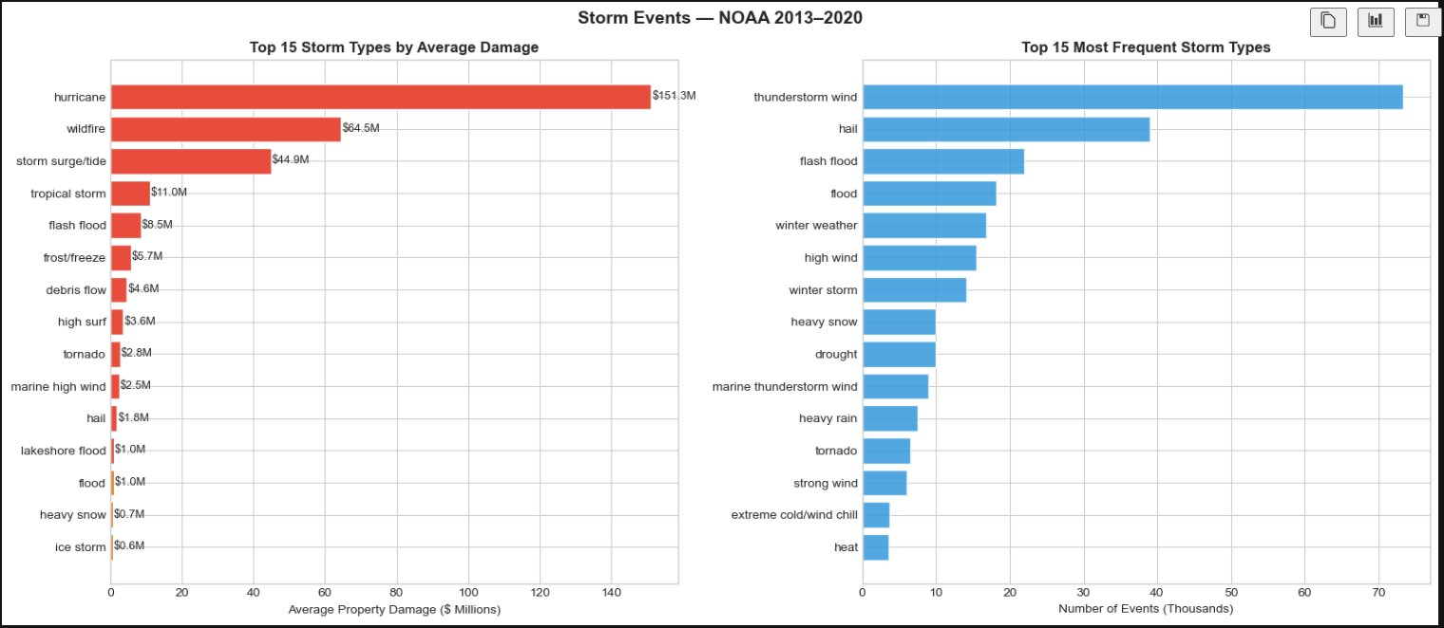
03
EDA: Frequency ≠ Severity
Key Insight
Most frequent
Thunderstorm wind: Happens most often but causes modest damage
Most expensive
Hurricane =$151M average per event :rare but catastrophic
Critical gap
The most frequent storm is NOT the most dangerous one
Implication
Counting events alone will cause an insurer to dangerously underestimate hurricane risk
NOAA Storm Damage Prediction · Suffolk University · ISOM 631 · April 2026

Slide 9
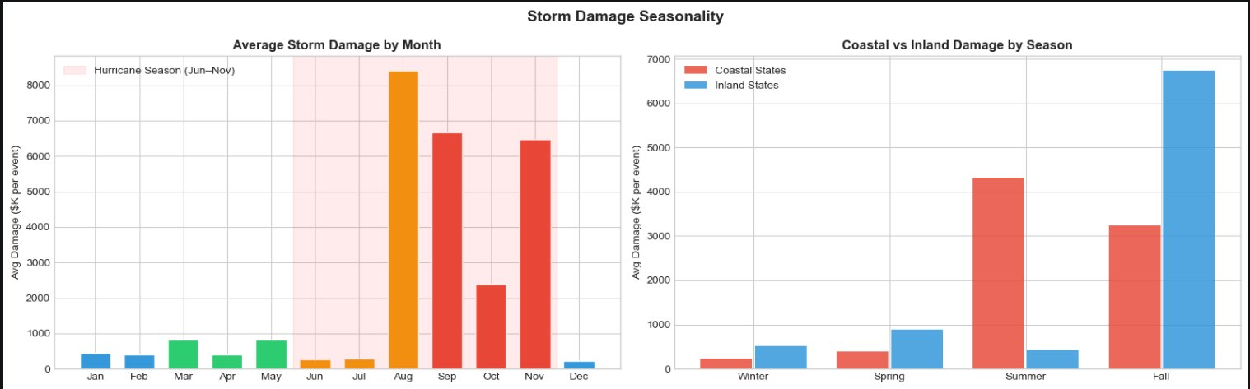
03
EDA: When and Where Does Damage Peak?
Key Findings
August peak
Highest avg damage month: peak hurricane season
Coastal 2.7×
Coastal states average 2.7× more damage than inland states across all seasons
Harvey effect
Fall inland spike driven by one large 2017 event (like Hurricane Harvey)
Our features
We built is_coastal and is_hurricane_season features to capture exactly these patterns
NOAA Storm Damage Prediction · Suffolk University · ISOM 631 · April 2026

Slide 10
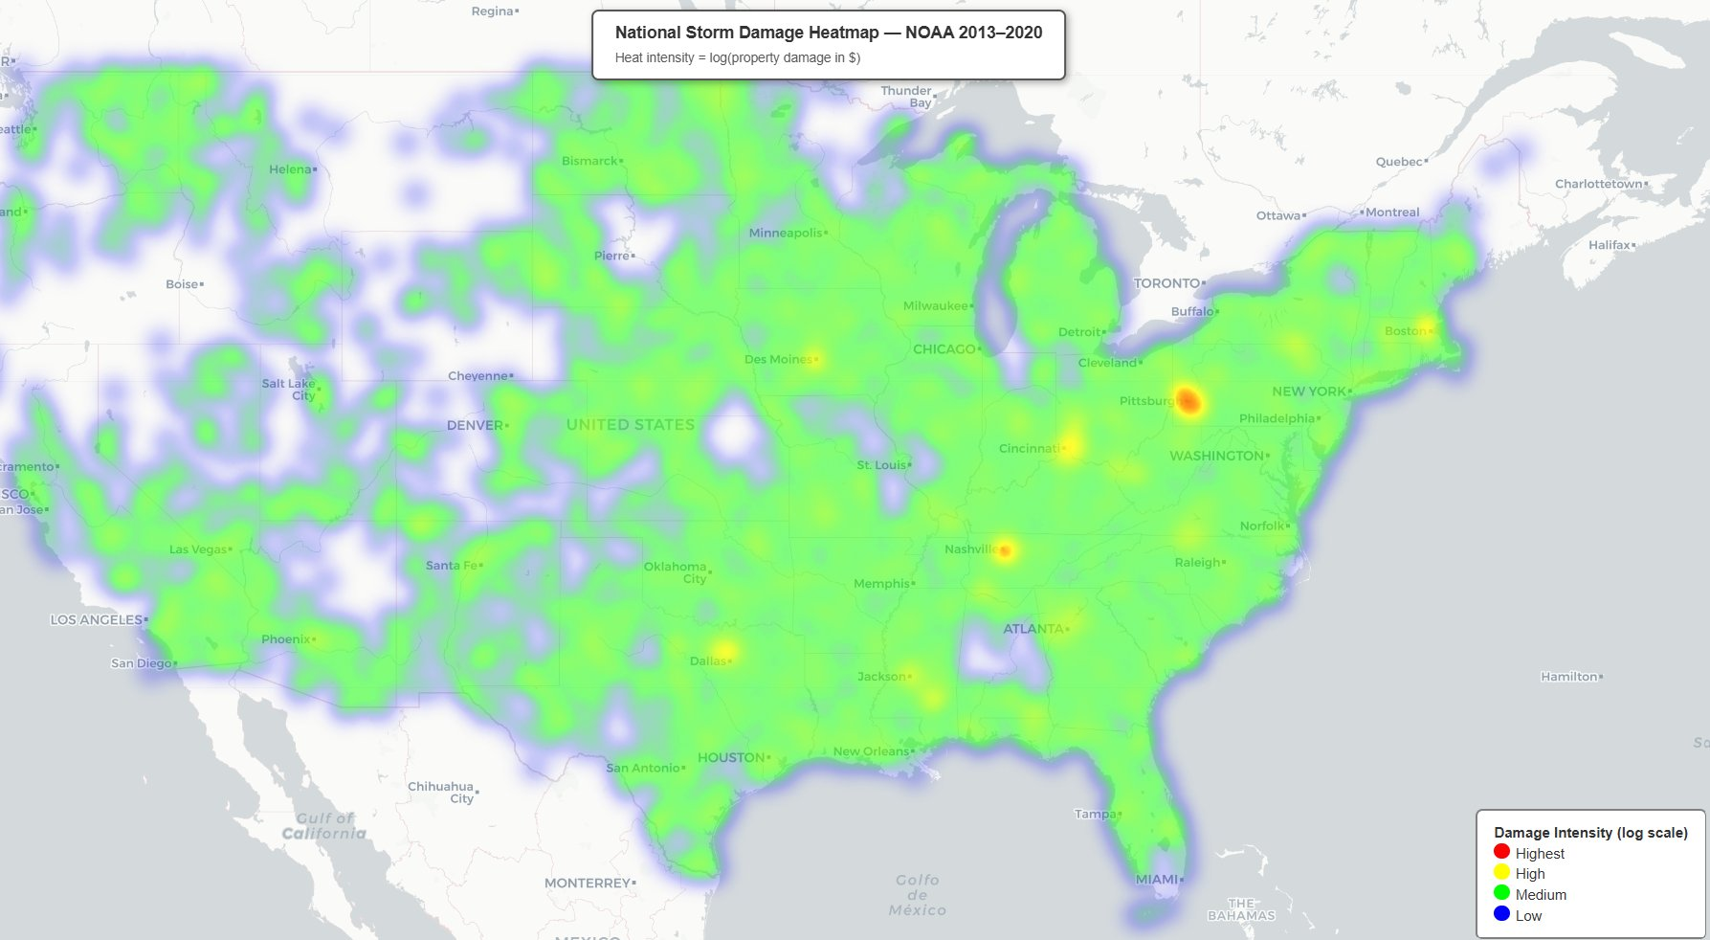
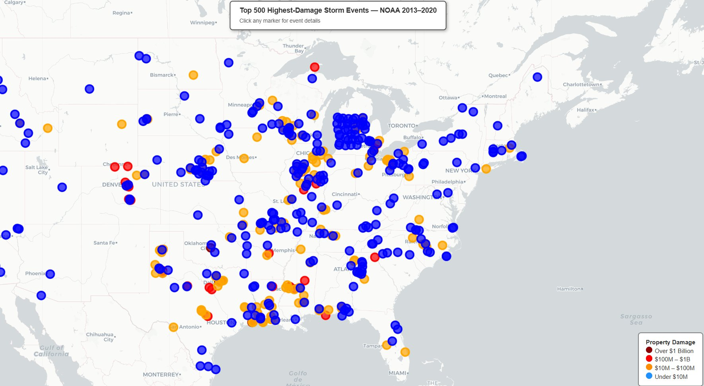
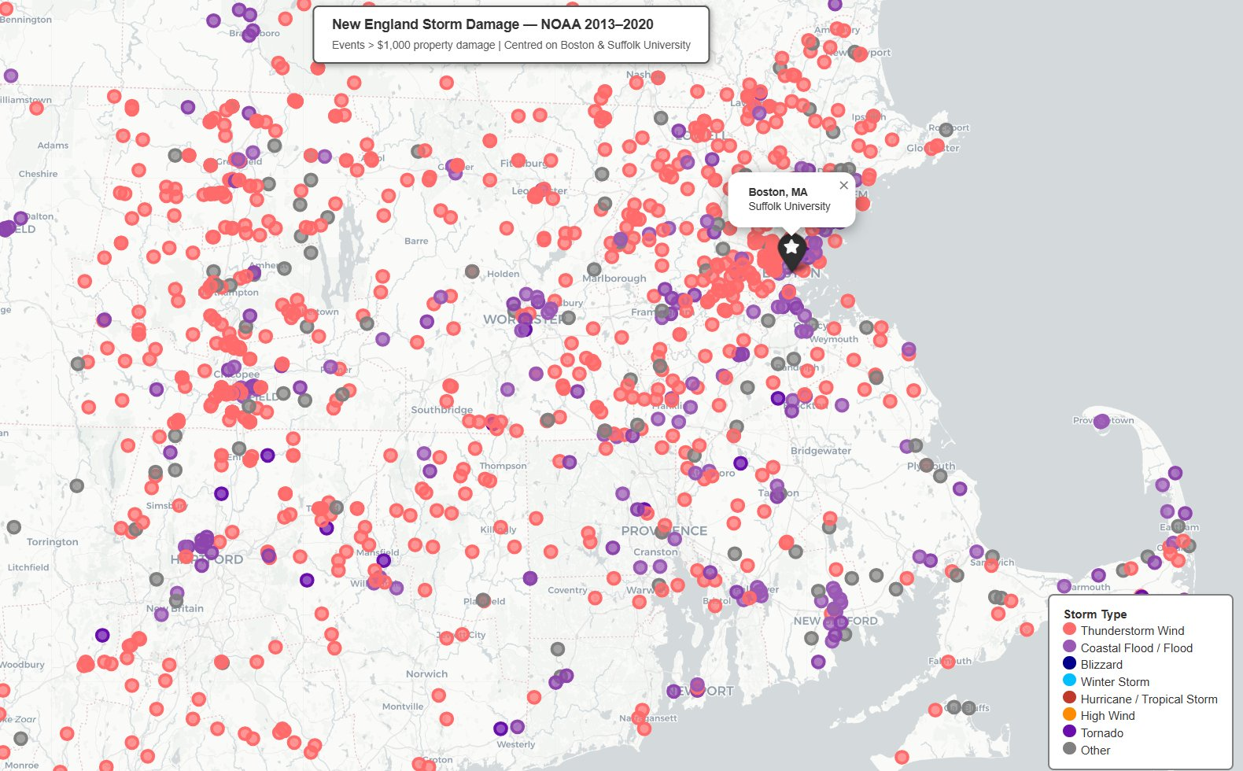
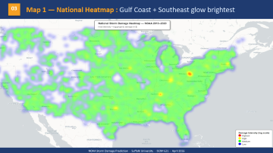
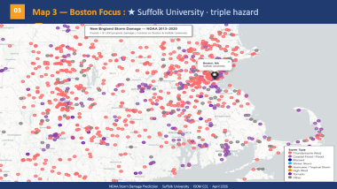

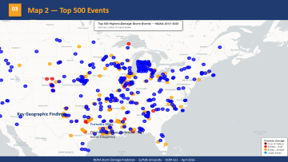
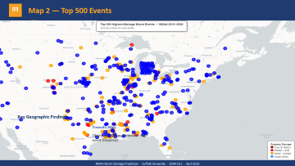

03
Geographic Analysis — Where Does Damage Concentrate?
Map 1 — National Heatmap
Map 2 — Top 500 Events
Map 3 — Boston Focus
Damage spreads across the East Coast and Midwest : hotspots visible nationwide
Bubble size = dollar damage
★ Triple hazard
Key Geographic Findings
Map 1 : Gulf & Southeast
Map 2:Tornado Alley
Map 3: New England:
Texas & Houston:
Coastal flood, thunderstorm wind, and other storm types clustered around Boston
Large damage events concentrated around Houston area : visible in Map 2
Gulf Coast & Southeast show the widest damage spread nationally; Pittsburgh and Nashville register the highest individual hotspots
Oklahoma & Texas : High event frequency in Tornado Alley corridor
NOAA Storm Damage Prediction · Suffolk University · ISOM 631 · April 2026

Slide 11
03
Map 1 — National Heatmap : Gulf Coast + Southeast glow brightest
NOAA Storm Damage Prediction · Suffolk University · ISOM 631 · April 2026

Slide 12
03
Map 2 — Top 500 Events
—
Key Geographic Findings
Tornado Alley
Oklahoma, Kansas, Nebraska : high event frequency
NOAA Storm Damage Prediction · Suffolk University · ISOM 631 · April 2026

Slide 13
03
Map 3 — Boston Focus : ★ Suffolk University · triple hazard
—
NOAA Storm Damage Prediction · Suffolk University · ISOM 631 · April 2026

Slide 14
04
Two-Stage Model
Feature engineering · Model architecture · Zero-inflation solution

Slide 15
04
Two-Stage Approach — Solving the Zero-Inflation Problem
73.7%
Stage 1 — Classification
Stage 2 — Regression
Which characteristics make damage more likely?
How many dollars of damage?
of storms → ZERO damage plain regression fails here
ALL 283,155 rows
74,514 rows only (damage > $0)
Accuracy 92.2% · AUC 0.9705
R² = 0.653 · RMSE 1.2194
24 Features : Including 6 We Built From Scratch
event_severity_score
is_coastal
storm_duration_hrs
Storm danger score : ranked 1 to 10 by destructive potential
Identify Coastal Location : 2.7× more damage coastal
How long the storm lasted
is_hurricane_season
mag_x_severity
state_target_enc
Captures whether it occurred during hurricane season (June–Nov)
Storm intensity × danger score combined
Which state was hit
NOAA Storm Damage Prediction · Suffolk University · ISOM 631 · April 2026

Slide 16
05
Results & Findings
Stage 1 · Stage 2 · Feature importance

Slide 17
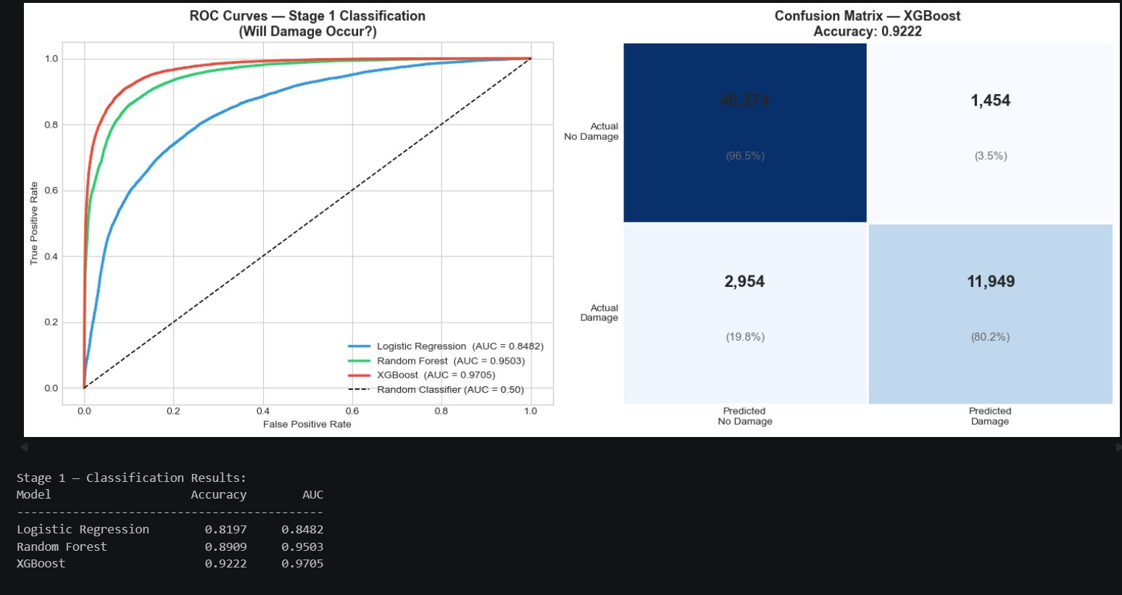
05
Stage 1: Which Characteristics Drive Damage?
Reading the Charts
ROC curve
Higher = better. XGBoost (red) is closest to the top-left corner.
AUC 0.9705
0.5=Random guess · 1.0=Perfect Ours: 0.97
Confusion grid
80% of real damage correctly flagged 96.5% of harmless storms correctly ignored
92.2%
0.9705
80.2%
XGBoost Accuracy
AUC Score
Damage Caught
92.2% correct predictions
Near-perfect separation
4 in 5 damaging storms correctly flagged
NOAA Storm Damage Prediction · Suffolk University · ISOM 631 · April 2026

Slide 18
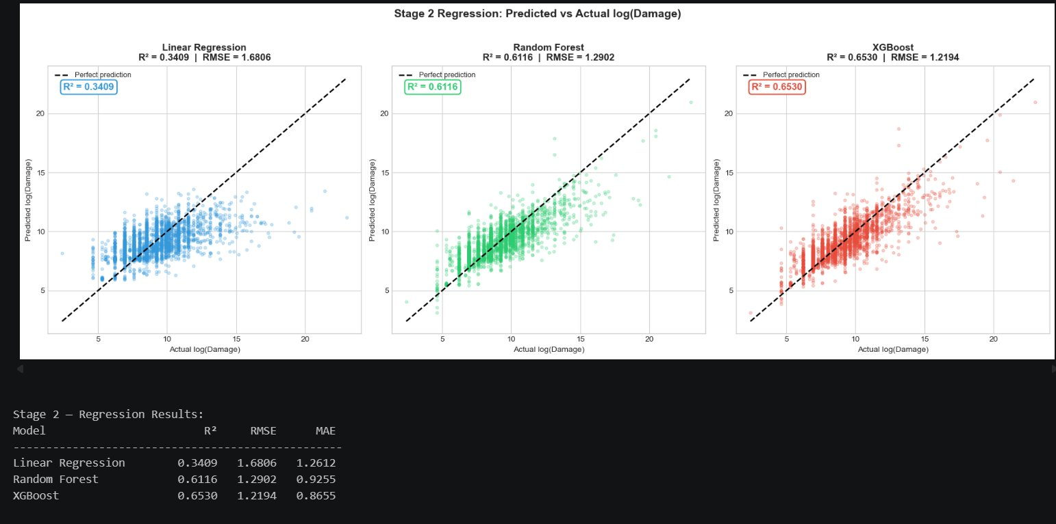
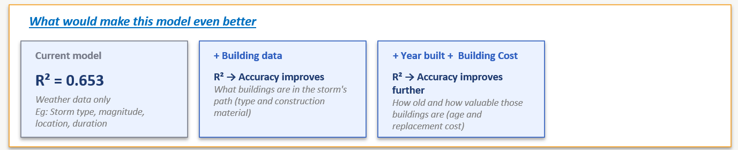
05
Stage 2: How Much Damage? — Predicted vs Actual
Reading the Charts
3 scatter plots
Each shows predicted vs actual log(damage)
Dashed line
= perfect prediction closer = more accurate
XGBoost wins
Tightest cluster around the perfect line

Slide 19
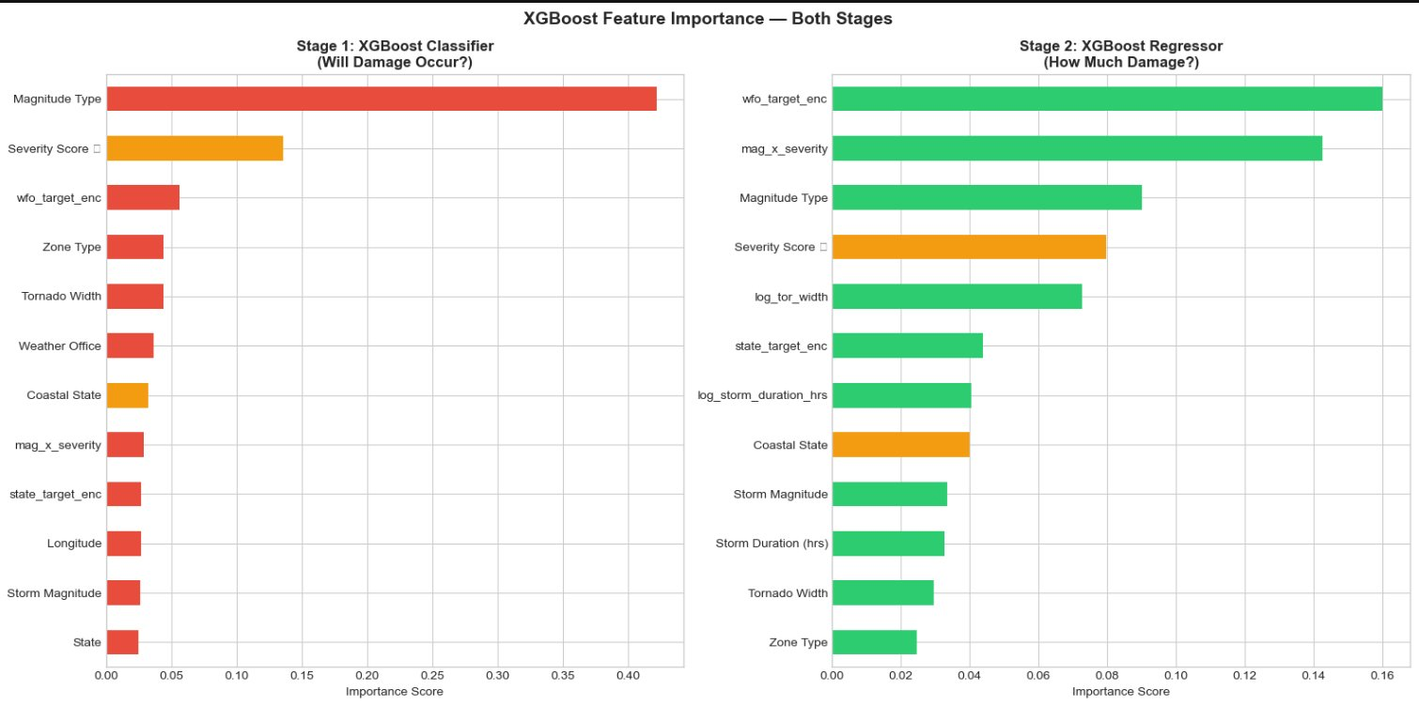
05
Feature Importance — Domain Knowledge in the Model
The Proof
Stage 1 #1
Magnitude Type: Acts as the primary "Category Signal," distinguishing between minor weather and major catastrophic events.
Stage 1 #2
Severity Score: A Strategic Risk Indicator that ranks storm types by historical destructiveness to provide the model with expert context.
Stage 2 #1
Wfo_target_enc: Average damage per Weather Forecast Office. Replaces ID numbers with the historical mean damage per local weather office to capture granular, high-risk geographic zones.
Stage 2 #2
mag_x_severity = magnitude × event_severity_score
Combines storm intensity with storm type. It ensures the model distinguishes between high-magnitude events of different types (e.g. a Tornado vs. a Thunderstorm at the same wind speed), capturing the true "combined punch" of the event.
NOAA Storm Damage Prediction · Suffolk University · ISOM 631 · April 2026

Slide 20
06
Business Application
Recommendations for a New England Insurance company

Slide 21
06
Actionable Recommendations
Identify damage the moment a storm is recorded
When NOAA logs a storm, our model instantly flags which locations suffered damage : the same day, not days later. Claims teams can dispatch adjusters to the right places immediately instead of waiting for slow manual field reports. In testing, the model correctly identified 8 out of every 10 damaging storm events using only storm type, location, and magnitude.
See where losses are piling up , before the bills arrive
When multiple policyholders in the same area are hit by the same storm, losses pile up fast. The model shows exactly where damage is clustering on a map : for example, multiple counties in Florida after a hurricane. This gives the company early warning to prepare reserves and notify reinsurers before the claims flood in.
Set financial reserves the same day, not weeks later
Once a storm is recorded, the model instantly estimates how much it will cost. No waiting weeks for field reports , finance gets a dollar figure the same day and can set aside the right amount of money immediately.
It is relevant for
NOAA Storm Damage Prediction · Suffolk University · ISOM 631 · April 2026

Slide 22
THANK YOU
"We identified which storm characteristics drive property damage : and built a two-stage system which estimates the dollar cost : the moment a storm is recorded, not days later.."
283K
92.2%
0.9705
0.653
Storm events
Stage 1 accuracy
AUC score
Stage 2 R²
Suffolk University · ISOM 631 · April 2026

